Slide 1
Managing Your Practice Through Times of Disruption
April 9, 2020

Slide 2
Presenters
Domenic Segalla
Principal, Team Leader, Healthcare Advisory
Stephanie Maresca, CPA
Senior Manager,
Healthcare Services

Slide 3
Today’s Webinar Will Cover
COVID-19 Relief Funding
CARES Act
Business Loan Assistance
Telehealth
Tracking Expenses, Revenue Loss, Reimbursement
Business Disruption

Slide 4
COVID-19 Relief FUNDING

Slide 5
COVID-19 Relief Funding
$8.3B Emergency Funding bill
$100B Families First Coronavirus Response Act
$2T Coronavirus Aid Relief and Economic Security (CARES) Act- $150B specifically for Healthcare

Slide 6
$8.3B Emergency Funding Bill
Provides aid to government health and vaccine research and development
Payments for prevention efforts
Quarantine costs
Sanitization efforts
Tracking of the virus
$3 billion in vaccine research
Payments to states through grant funding based on a population-based CDC formula

Slide 7
$100B Families First Coronavirus Response Act
Includes provisions for emergency paid leave for workers and free testing
Two weeks of paid leave for organizations with fewer than 500 employees
$1 billion Increased funding for food assistance programs
Testing for COVID-19
Waives all patient cost-sharing for COVID-19 tests
Applies to Medicare, Medicaid State Children’s Health Insurance Program (SCHIP), Tricare, Veterans Administration and Indian Health Services
Medicare covers 100% of payment for COVID-19 tests
Prohibits prior authorization for COVID-19 testing
Medicaid eligibility to the uninsured for COVID-19 testing
Increases federal matching funds for Medicaid program by 6.2%

Slide 8
Coronavirus Aid Relief and Economic Security (CARES) Act- $100B for Healthcare
Suspends 2% sequestration reduction in Medicare payments, beginning May 1 and lasting through Dec. 31, 2020.
Increases Medicare payments by 20% for coronavirus cases for discharges with principal or secondary diagnosis of COVID-19. The weighting factor for each diagnosis-related group will be increased by 20%. This increase will be for COVID-19 cases during the emergency period (beginning March 13 and ending when the national emergency is declared over).
Provides accelerated payments through Medicare periodic lump sum payments to hospitals up to 100% and for critical access hospitals up to 125% for a six-month period. This would be a loan allowed to be repaid twelve months from the date of first payment.
Delays Medicaid Disproportionate Share Hospital payments from May 22, 2020 to November 30, 2020.
Provides cash flow for the financial impact from halting elective and non-urgent procedures.

Slide 9
Cares act: Business Loan Assistance

Slide 10
SBA Assistance
SBA has several different financial assistance programs for small businesses
SBA Disaster Assistance Loans for businesses impacted by COVID-19
Economic Injury Disaster Loan (EIDL) Program –may be used to pay fixed debts, payroll, accounts payable and other bills that can’t be paid because of the disaster’s impact
Emergency EIDL Grants up to $10,000
Standard 7(a) Loan Program with amendments under the CARES Act
Express Loan Program – increased amount from $350,000 to $1,000,000

Slide 11
SBA EIDL

Slide 12
SBA EIDL
Entities eligible
Sole-proprietor (with or without employees); independent contractor; business, cooperative, ESOP tribal small business concern with not more than 500 employees, and entities that meet the small business definition of the SBA
Maximum Loan Determined by SBA: $2,000,000
Interest Rates: 3.75% for businesses and 2.75% for nonprofit entities
Term: up to 30 years
SBA is waiving
“credit elsewhere” clause
Personal guarantees for loans under $200,000
Applicant needs to be in business for 1 yr. (but must have started prior to 1/31/20)
SBA can approve based solely on credit score and not require tax returns
May be used to pay fixed debts, payroll, accounts payable and other bills that can’t be paid because of the disaster’s impact

Slide 13
EIDL Emergency Advance
Complete application on line
Receive an advance of up to $10,000
Can be rolled into PPP loan
Caseworker will contact borrower for next steps

Slide 14
SBA 7(a) Loan under paycheck protection program

Slide 15
PPP Overview
Up to $349B in forgivable loans to small businesses to pay their employees during the COVID-19 crisis
Loans must be obtained before June 30, 2020
Lenders need time to process the loan and there is a funding cap, but Treasury Secretary Mnuchin announced on 4/1/2020 that additional funds would be made available as necessary
Applications made to private lenders that are approved by the SBA for 7(a) loans
Will need to provide payroll documentation
Other required documentation unclear at this time
Application period opens April 3, 2020 for small businesses and sole proprietorships
April 10, 2020 for independent contractors and self-employed individuals
Loan terms will be identical for all applicants

Slide 16
PPP
Certifications of borrower made under penalties of perjury
Current economic uncertainty makes the loan necessary to support your ongoing operations
Funds will be used to retain workers and maintain payroll or to make mortgage, lease, and utility payments
You have not and will not receive another loan under this program
To the extent feasible, you will purchase only American-made equipment and products
And others . . .

Slide 17
PPP (cont’d)
Eligible borrowers
All businesses, including 501 (c)(3) nonprofits and veterans organizations and Tribal business concerns
Small business concerns with 500 or fewer employees (including FTEs and PTEs)
If more than 500 employees -
May qualify if it meets the SBA employee based or revenue based size standard corresponding to their “primary” industry
If they don’t meet this standard can still qualify if
They meet the SBA’s “alternative size standard as of March 27, 2020
Maximum tangible net worth is not more than $15MM AND
Average net income after federal taxes (excluding carryover NOLs) is not more than $5Mm for the last two full years
Includes sole-proprietors, independent contractors and eligible self-employed individuals
Affiliation rules apply – businesses under common control need to aggregate all entities to determine the number of employees
Waived for small business (i) in the NAICS code 72 (hotel and food services) and (ii) that are franchises in the SBA’s Franchise Directory, and (iii) that receive financial assistance from small business investment companies licensed by the SBA

Slide 18
PPP (cont’d)
Ineligible borrowers
Businesses engaged in any activity illegal under federal, state or local law
You are a household employer (you employ nannies, housekeepers)
An owner of 20% or more of the equity who is incarcerated, on probation or parole
Delinquent on any loan from SBA in past 7 years

Slide 19
PPP (cont’d)
Payroll Costs
Employee (covers compensation up to $100,000 annually)
Wages, salary, commissions, or tips (up to cap of $100K/year/person)
Vacation, parental, family, medical, or sick leave
Dismissal or separation payments
Payments for group health care benefits, including insurance premiums
Retirement benefits
Employer state or local taxes on compensation
DOES NOT INCLUDE INDEPENDENT CONTRACTORS
Sole proprietor or independent contractor (up to $100,000 annually)
Wage; commission; income; net earnings from self-employment
Excludes (i) employer’s share of Federal employment taxes and federal income tax withholding, (ii) compensation to an employee whose principal place of residence is outside the United States, and (iii) qualified sick leave and family leave under the Families First Coronavirus Response Act

Slide 20
PPP (cont’d)
Maximum Loan amount (capped at $10,000,000)
2.5 times the average monthly payroll costs incurred during the last 12 months before the date on which the loan is made PLUS
Outstanding amount of loans under 7(b)(2) that were made during January 31, 2020 and April 3, 2020 less the amount of any “advance” under the EIDL Covid-19 loan (because it does not have to be repaid)

Slide 21
PPP (cont’d)
Loan Terms
One loan per person
In general, the maximum loan amount is the lesser of:
$10,000,000, or
250% of the average monthly payroll costs incurred during the 1 year period before the date on which the loan is made
Not clear whether banks will use monthly average during 2019, or 12-month rolling average
Lender will calculate the amount of the loan – review calculations
No need to prove credit is unavailable elsewhere (i.e., waiver of Credit Elsewhere requirement)
Interest rate to 1% (based on Interim Final Rule released 4/2/20)
Term 2 years from date borrower applies for loan forgiveness
No collateral required – loan is 100% guaranteed by the SBA
No personal guarantee required
No prepayment penalties or fees
Deferral for 6 months following the date of the loan; interest will accrue from date of loan
Borrower can obtain EIDL after 1/31/20 and until 4/3/20 is obtained if used for a purpose other than payroll costs

Slide 22
PPP (cont’d)
Uses of loan proceeds
Payroll costs (per SBA fact sheet)
Rent under a lease in force before 2/15/2020
Utilities for which service began before 2/15/2020
Interest on mortgage obligations incurred before 2/15/2020
Interest on any other debt obligation incurred before 2/15/2020 (per statute, but not SBA fact sheet)

Slide 23
PPP (cont’d)
Loan Forgiveness
Includes all eligible expenses paid during the 8-week period after the loan is made
Eligible expenses:
Payroll costs (up to $100K/year/employee – presumably same rules as loan use rules apply)
Interest on mortgages incurred before 2/15/2020
Rent under a lease in force before 2/15/2020
Utilities for which service began before 2/15/2020 (e.g., electric, gas, water, transportation, telephone, and internet)
Cannot exceed the principal amount of the loan
Anticipated that no more than 25% of amount forgiven can be for non-payroll costs (per SBA fact sheet)
Amount is tax-free to the borrower
Amount of forgiveness is reduced if there are certain headcount or wage reductions
Borrower will need to document the number of FTEs and pay rates, as well as the use of funds for all purposes
Lender has 60 days to made a decision after it receives a completed application for forgiveness

Slide 24
PPP (cont’d)
Reduction based on headcount reduction
Multiply total eligible expenses paid during 8-week period after loan is made (covered period) by the following fraction:
Average number of FTEs per month during 8-week period after the loan is made, divided by
At the election of borrower:
Average number of FTEs per month during 2/15/19 to 6/30/19, or
Average number of FTEs per month during 1/1/20 to 2/29/20
Reduction based on wage reduction
Reduction amount per employee is equal to:
the amount by which total salary and wages paid during the covered period is less than 25% of total wages paid during most recent full quarter before the covered period
Although unclear, calculation of the reduction applies only to employees making less than $100K/year
Can restore headcount and wages by 6/30/2020 to account for any reductions made between 2/15/2020 and 4/26/2020)

Slide 25
TO DO’s
Talk with current banker
Do they provide SBA loans
What information will they need beyond the standard application
Gather financial data to be ready to provide to bank
For example:
Payroll records for 2019 and 2020 (monthly)
Financial statements – 3 years if you have them
Personal financial statements for all owners over 20%
Tax returns for last three years
Schedule of all debt (mortgages, notes, accounts payable)
Proof of payments made for rent, utilities and interest after the loan is received

Slide 26
DISCLAIMER
The views in this document are not necessarily the views of WithumSmith+Brown, PC. These are the interpretation of the presenter and cannot be relied upon without a full review of the CARES Act released on March 27, 2020 and the subsequent SBA Interim Final Rule released on April 6, 2020.
It is your responsibility to perform your own interpretation of the guidance that has been published.

Slide 27
CARES Act: Telehealth

Slide 28
CMS and the federal government have lifted many restrictions on the use of telemedicine
Effective March 1 and throughout the national public health emergency, Medicare will pay physicians for telehealth services at the same rate as in-office visits for all diagnoses, not just services related to COVID-19.
Office-based physicians should use their usual place-of-service (POS) code to be paid at the non-facility rate for telehealth services and add modifier 95 to telehealth claim lines. Telehealth services billed using POS code 02 (telehealth) will be paid at the facility rate.
Physicians can reduce or waive Medicare patient cost-sharing for telehealth visits, virtual check-ins, e-visits, and remote monitoring services.
Code selection and documentation guidelines for office visits performed via telehealth will be based on physician time spent on the date of visit or medical decision-making (MDM). CMS will utilize the 2020 physician time and definitions of MDM.

Slide 29
Expanded Access
Patients in all settings can now receive telehealth services
Physicians may provide telehealth services to new and established Medicare patients.
Consent for telehealth services may be obtained by staff or the practitioner at any time, required only once on an annual basis.
Physicians can provide telehealth services from their home. Physicians do not need to update their Medicare enrollment file with their home address.
Physicians licensed in one state can provide services to Medicare beneficiaries in another state. State licensure laws still apply.

Slide 30
Expanded Services
Physicians can now provide audio-only telephone evaluation and management visits for new and established patients
Now includes emergency department visits.
CMS is allowing medical screening exams , a requirement under Emergency Medical Treatment and Labor Act, to be performed via telehealth.
CMS removed frequency limitations on a number of Medicare telehealth services.
Physicians can provide remote patient monitoring services to both new and established patients for both acute and chronic conditions and for patients with only one disease.
Practitioners such as licensed clinical social workers, clinical psychologists, physical therapists, occupational therapists, and speech-language pathologists will have expanded access to telehealth, virtual check-ins, e-visits and telephone calls during the crisis.

Slide 31
Prescribing Controlled Substances
The U.S. Drug Enforcement Administration will permit physicians to prescribe controlled substances based on telehealth visits during the pandemic. State laws apply.
DEA will allow physicians treating patients with opioid use disorder who have a waiver allowing them to prescribe buprenorphine to issue these prescriptions based on a telephone visit.

Slide 32
Use of Technology for Telehealth Services
Any two-way audio-visual device is acceptable such as Facetime, Skype, or Zoom. However, per the Office for Civil Rights (OCR), which enforces HIPAA, physicians should not use Facebook Live, Twitch, TikTok or other public facing communication services.
OCR helpfully announced that it will use its enforcement discretion for physicians using telehealth, so that—for example—if they do not have time to conduct a security risk analysis or enter into a business associate agreement (BAA), they can still use telehealth to see patients during the crisis without fear of HIPAA penalties.
The OCR guidance emphasized that physicians are encouraged, but not required, to notify patients of the potential security risks of using these services and to seek additional privacy protections by entering into BAAs.

Slide 33
CARES Act: Tracking expenses and revenue loss for Covid-19 Reimbursement

Slide 34
Track Lost Revenue
There will be significant revenue lost from elective and non-urgent procedures that are postponed or canceled. It is important to be organized and track lost revenue and costs.
Set up a tracking mechanism for Covid-19 related costs
Use the correct billing codes for Covid-19 cases
Be prepared to understand and documents expenses incurred and lost revenues
The excel spreadsheet that FEMA is recommending to use to track lost revenue and increased expenses at this link:
https://www.cdc.gov/cpr/readiness/healthcare/disasterbudget.htm

Slide 35
Business Disruption

Slide 36
Steps to Take
Speak with your bank about increasing lines of credit to use as a safety net during a time of cash-crunch.
Conserve cash, planning for varying lengths of time of reduced revenue flow.
Look for alternate sourcing beyond your current vendors if they are unable to deliver goods at this time.
Extend payment terms with vendors, only done with transparent discussions between both parties.
Cut or delay non-essential expenses such as travel, entertainment and marketing.
Review your insurance policies for business interruption coverage.
Keep team morale up. It is during times like this when effective leadership is required most. Your teams will look to you for an optimistic, yet realistic, outlook. They need to feel assured that you have a plan which will keep them and the business healthy.

Slide 37
Thank you! Questions?

Slide 38
Contact Your Presenters
Domenic Segalla
Principal, Team Leader, dsegalla@Withum.com
(917) 734 9485
Stephanie Maresca, CPA
Senior Manager,
smaresca@Withum.com
(732) 740 7454

Slide 39
I Started My Business on February 19, 2020 can I apply for the EIDL or PPP Loan?
No.

Slide 40
How do I determine number of employees?

Slide 41
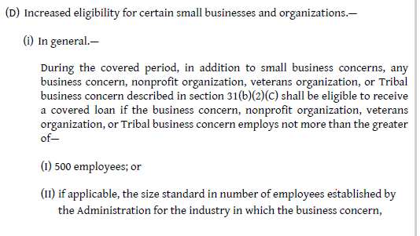
If I have more than 500 employees can I still apply for a PPP loan?
Yes if the size standard applicable to your industry uses a higher threshold for number of employees

Slide 42
How do I calculate the PPP Loan amount?
From the Interim Final Rule (4-2-20)

Slide 43
How do you determine payroll costs?
Depends on who you ask

Slide 44
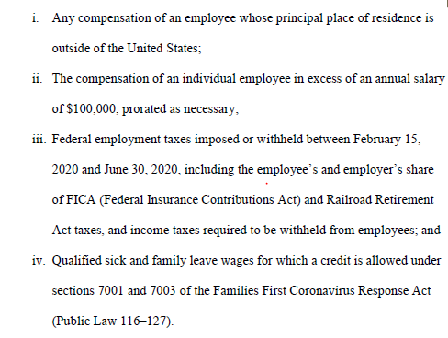
Interim Final Rule (4-2-20)

Slide 45
US Treasury Borrower Fact Sheet

Slide 46
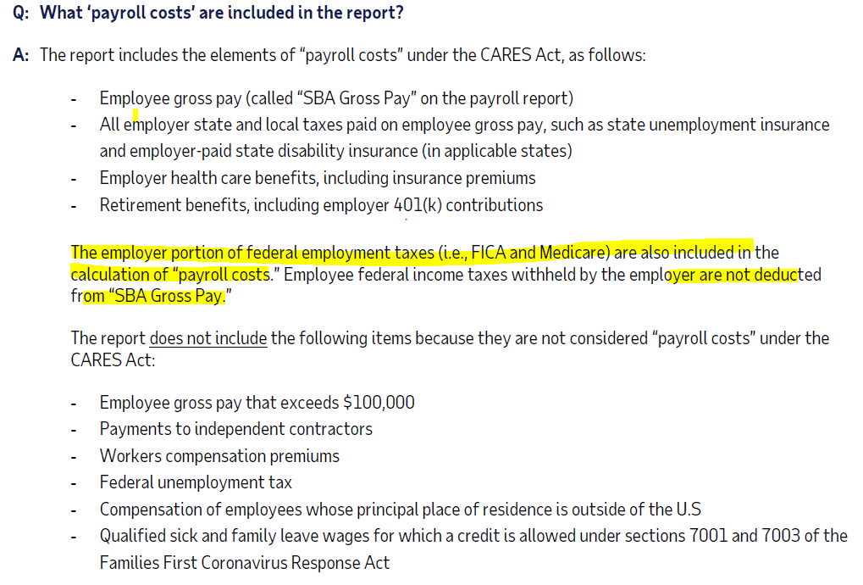
ADP

Slide 47
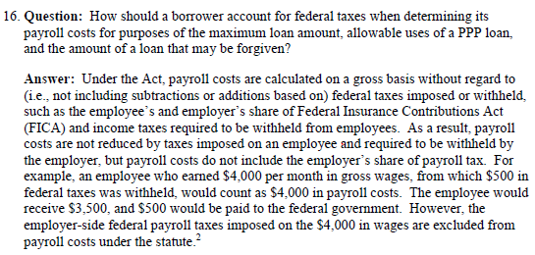
FAQ Issued 4-6-20

Slide 48
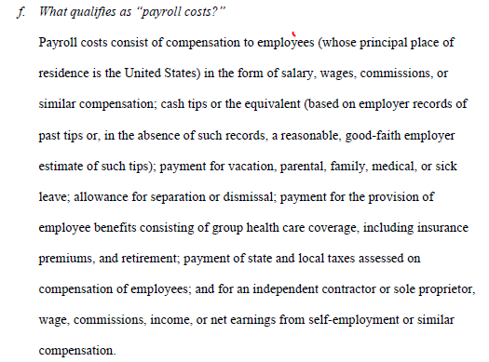
Should We Include Workers Comp Ins?
Do you see workers comp
Insurance ---------→

Slide 49
What Period of Payroll Costs do I use – Last 12 Months or Calendar 2019?
IT DEPENDS

Slide 50
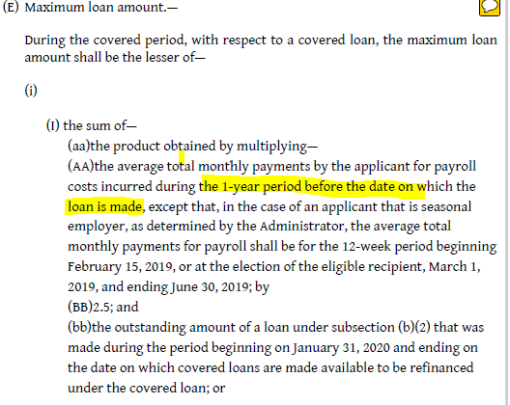
Interim Final Rule (4-2-20)
But wait….

Slide 51
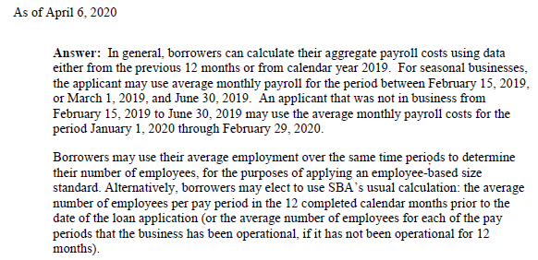
FAQ issued 4-6-20

Slide 52
PPP Borrower Loan Application Form 2483

Slide 53
How does a sole proprietor calculate payroll costs?
For employees same as we stated before
For the sole proprietor / independent contractor:
Wages, commissions, income, or net earnings from self-employment capped at $100,000

Slide 54
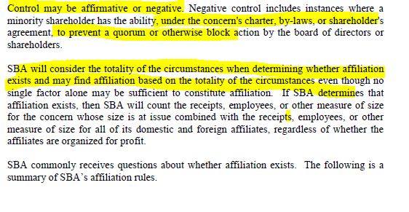
Explain Affiliation Rules Again?

Slide 55
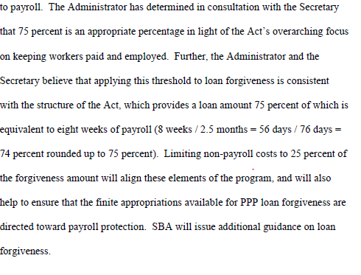
Can you further explain the forgiveness calculation?
Taken from the Interim Final Rule (4-2-20)

Slide 56
What would cause the loan not to be fully forgiven?
Based on Number of FTEs (this yields a % of the loan reduced)
If the average number of FTEs during the 8 week period after the loan origination is less than the average # of FTEs during either the period 2/15/19 to 6/30/19 or 1/1/20 to 2/29/20 (which ever gives better outcome)
AND
Based on reduction in wages (this yields a $ amount of the forgiveness reduced)
Any reduction in total salary or wages of any employee during the 8 week period after loan origination that is in excess of 25 percent of the total salary or wages of the employee during the most recent full quarter during which the employee was employed before the loan origination.

Slide 57
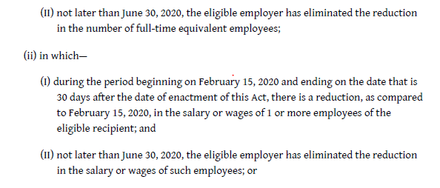
What if I laid off workers?

